Slide 1
Car Management System

Slide 2

Table of Contents
01
02
03
04
Introduction
Analysis Diagrams
Code & Explanation
Output
05
Conclusion

Slide 3
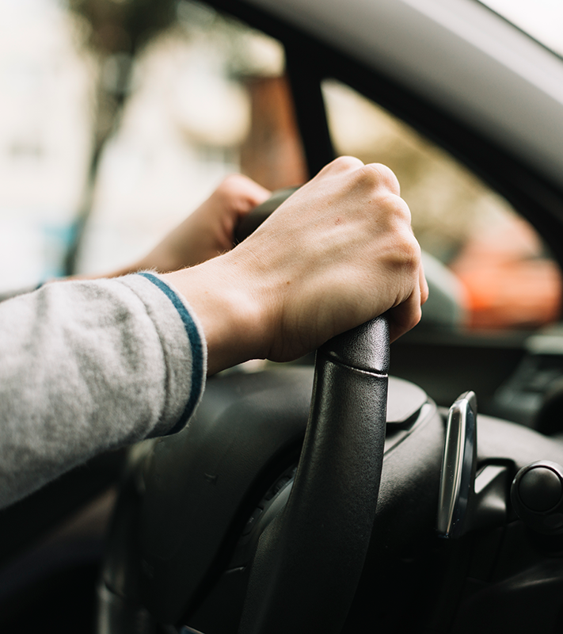
01
Introduction
HOME

Slide 4
Car management system are computer-based solution designed to improve the management of cars associated operations. This system involves the integration of software, hardware, and communication technologies to help managers monitor and control their vehicles effectively.
These systems are widely used by transportation companies, logistics companies, and other organizations that manage large fleets of cars.

Slide 5
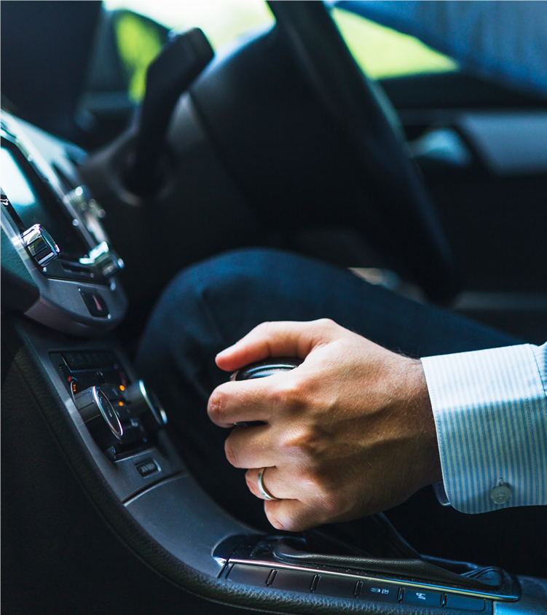
02
Analysis Diagrams
HOME

Slide 6
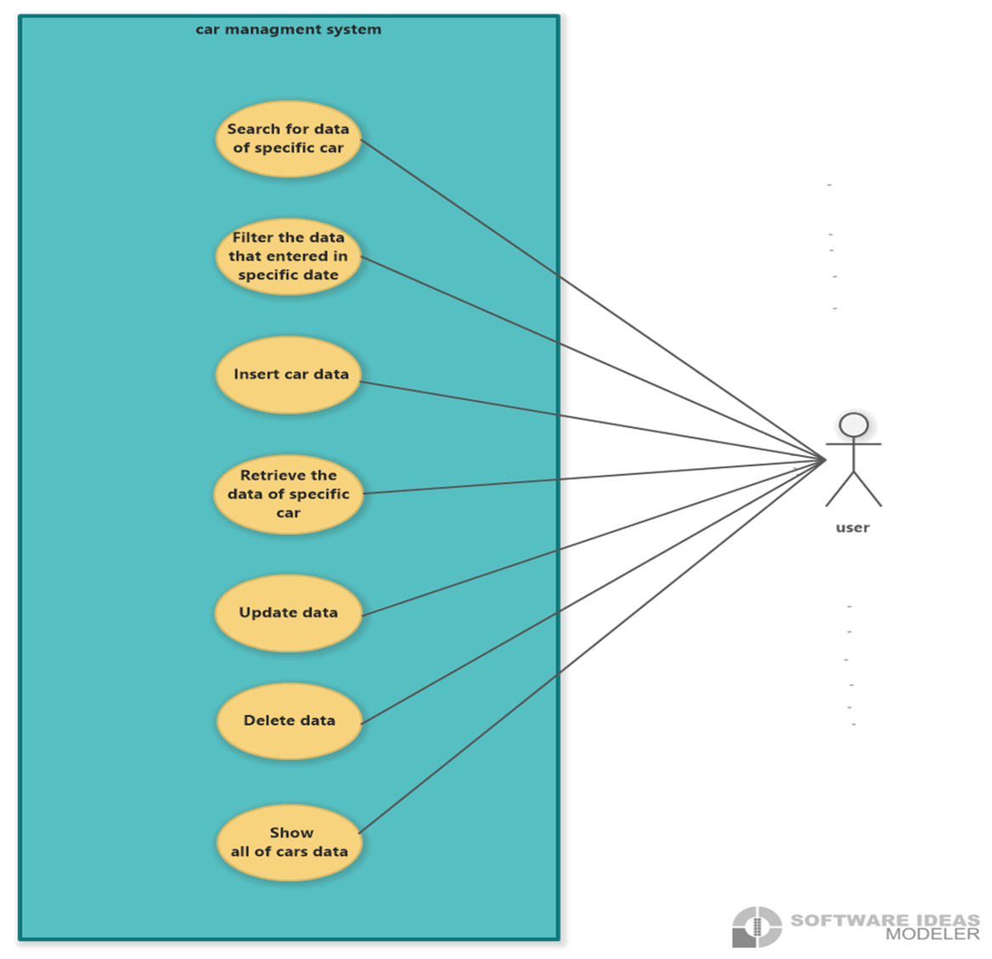
Use Case Diagram
The user can delete data
The user can search for data of specific car
The user can show all of cars data
The user can filter the data that entered in a specific date
The user can insert car data
The user can retrieve thee data of specific car
The user can update data

Slide 7
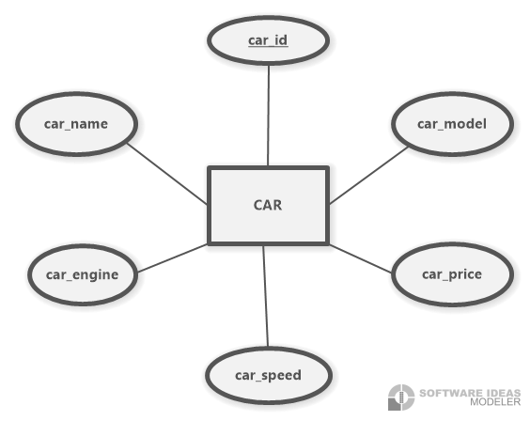
ERD

Slide 8
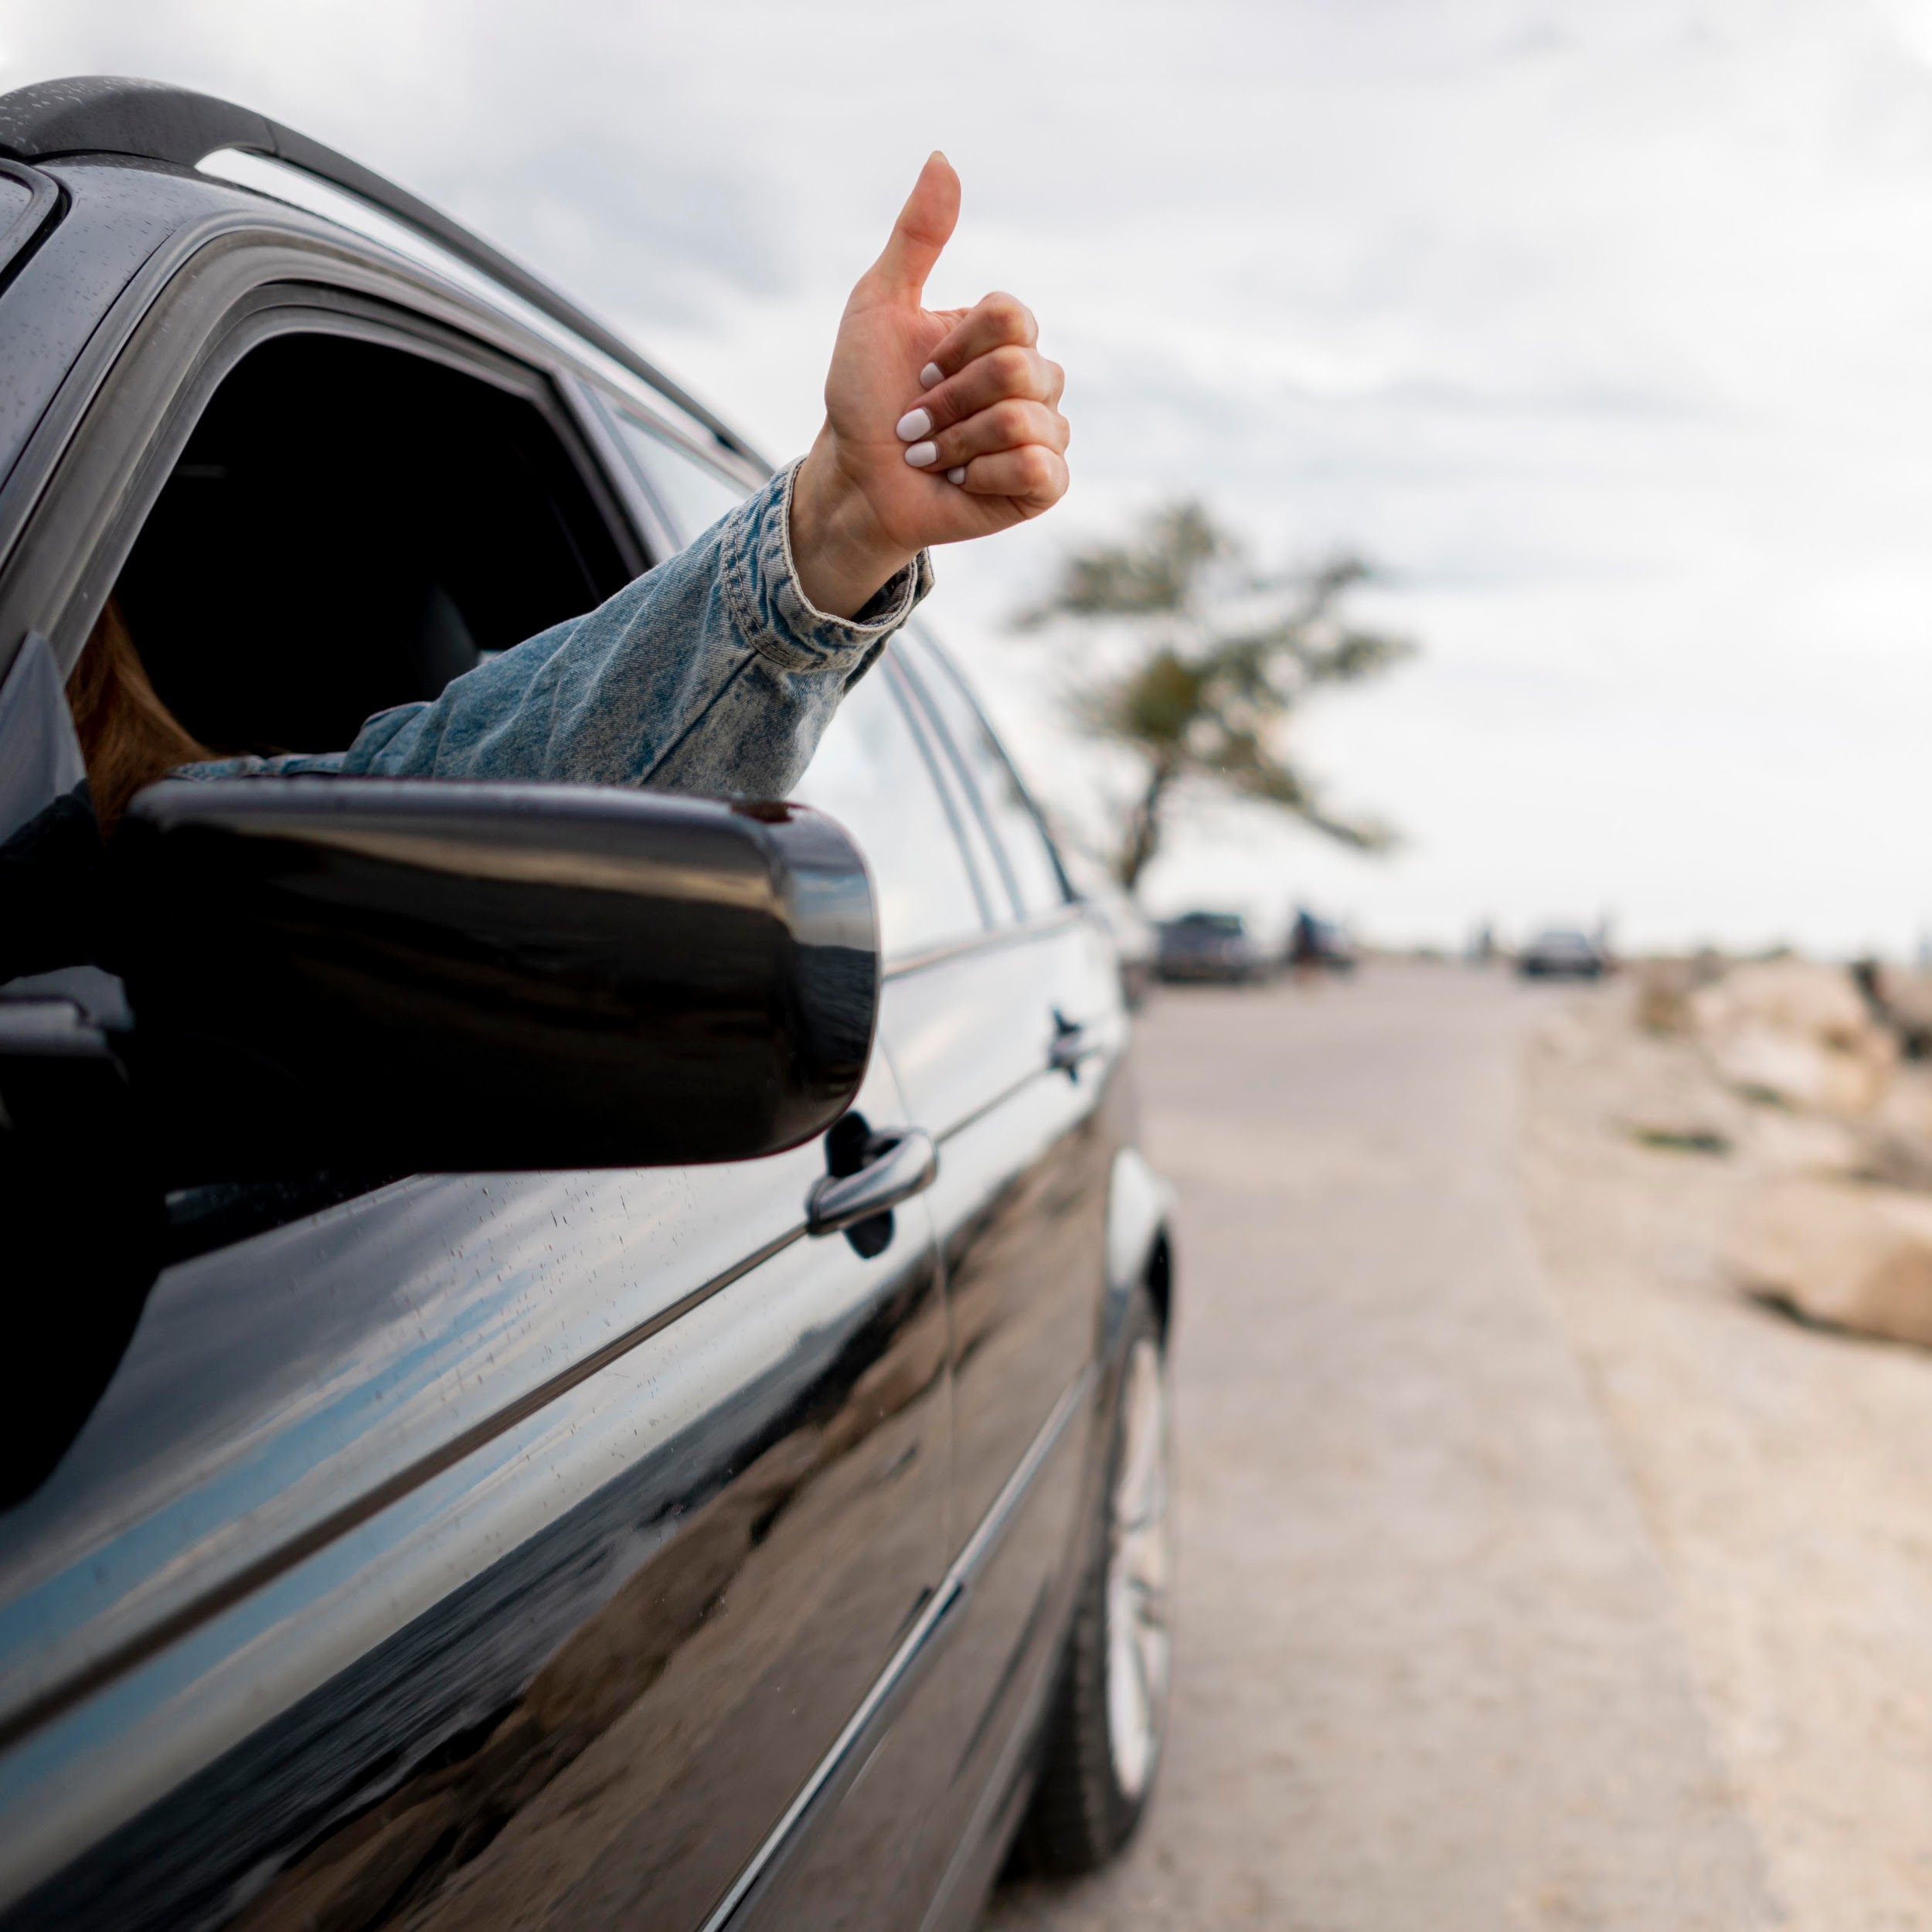
03
Code & Explanation
HOME

Slide 9
tkinter as tk: This module is used to create GUI applications. It provides a set of tools for creating windows, buttons, labels, etc. ImageTk, Image: These modules are used to display images in the GUI. time: This module provides various time-related functions. ttk: This module provides advanced widgets for creating more complex GUIs. messagebox: This module provides a set of functions for displaying message boxes. Calendar, DateEntry: These modules are used to create calendars and date entry widgets. datetime: This module provides various functions for working with dates and times. sqlite3: This module provides an interface for working with SQLite databases.
import tkinter as tk from PIL import ImageTk,Image import time from tkinter import ttk from tkinter import messagebox from tkcalendar import Calendar, DateEntry from datetime import datetime import sqlite3

Slide 10
conn = sqlite3.connect('Car.db')
This line of the code creates a connection to an SQLite database named “Car.db” using the connect() method provided by the sqlite3 module. The connection object is stored in the variable conn.
Overall, the code creates a GUI application that allows users to enter data (such as a name and a selected date) and saves it to a database. Users can also view the saved data at any time.
window = tk.Tk() window.geometry('850x655-200-60') window.title('Car Managment System') window.configure(background='#6A6A6A') window.resizable(width=False, height=False)
window = tk.Tk(): This line creates a new window object using the Tk() method provided by the tkinter module.
window.geometry('850x655-200-60'): This line sets the size and position of the window. window.title('Car Managment System'): This line sets the title of the window to “Car Management System”.
window.configure(background='#6A6A6A'): This line sets the background color of the window to a dark gray color.
window.resizable(width=False, height=False): This line prevents the user from resizing the window.

Slide 11
icon = tk.PhotoImage(file='car_img.png'): This line loads an image file named “car_img.png” and creates a new PhotoImage object from it. window.call('wm','iconphoto',window._w,icon): This line sets the icon of the window to the image loaded in the previous line.
icon = tk.PhotoImage(file='car_img.png') window.call('wm','iconphoto',window._w,icon)
emp_id,emp_name,emp_age = tk.StringVar(),tk.StringVar(),tk.StringVar() emp_email,emp_phone,emp_salary = tk.StringVar(),tk.StringVar(),tk.StringVar()
emp_id, emp_name, emp_age = tk.StringVar(), tk.StringVar(), tk.StringVar(): These lines create three new StringVar() objects and assign them to the variables emp_id, emp_name, and emp_age. These objects are used to store string values that can be displayed in the GUI.
emp_email, emp_phone, emp_salary = tk.StringVar(), tk.StringVar(), tk.StringVar(): These lines create three more StringVar() objects and assign them to the variables emp_email, emp_phone, and emp_salary.

Slide 12
This code block is used to create Database , Table for inserting the data.
cur = conn.cursor() cur.execute("""CREATE TABLE IF NOT EXISTS emp_data ( ID TEXT NOT NULL PRIMARY KEY ,Name TEXT NOT NULL, Age TEXT NOT NULL,Email TEXT NOT NULL, Phone TEXT NOT NULL,Salary TEXT NOT NULL, Date_save TEXT NOT NULL) """) cur.close()

Slide 13
This Function is responsible for inserting the data of the car
def insertData(): cur = conn.cursor() Car_id = emp_id.get(); Car_name = emp_name.get() Car_age = emp_age.get(); Car_email = emp_email.get() Car_phone = emp_phone.get(); Car_salary = emp_salary.get() date_emp = str(datetime.now().date()) if Car_id == '' or Car_name == '' or Car_age == '' or Car_email == '' or Car_phone == '' or Car_salary == '': messagebox.showwarning('Missed values', 'There are some blank fields please check again') else: insertQuery = "INSERT INTO emp_data (ID,Name,Age,Email,Phone,Salary,Date_save) VALUES (?,?,?,?,?,?,?)" val = (Car_id,Car_name,Car_age,Car_email,Car_phone,Car_salary,date_emp) cur.execute(insertQuery,val) if insertData: messagebox.showinfo("Car Insertion","Car has been inserted successfully") emp_id.set('');emp_name.set('');emp_age.set('');emp_email.set('');emp_phone.set('');emp_salary.set('') conn.commit() get_data()

Slide 14
This Function is used to show the data of all cars in the database
def get_data(): global myData cur = conn.cursor() Car_id = emp_id.get() #sel_data = ("SELECT * FROM emp_data WHERE ID=?") #cur.execute("SELECT * FROM emp_data WHERE ID=?"+Car_id) query = "SELECT ID,Name,Age,Email,Phone,Salary FROM emp_data" cur.execute(query) myData = cur.fetchall() updateData(myData)
def search_Car(): cur = conn.cursor() search_name = searchEnt.get() if search_name in emp_ids_list: query = "SELECT ID,Name,Age,Email,Phone,Salary FROM emp_data WHERE ID LIKE ? OR Name LIKE ?" cur.execute(query,(search_name,search_name)) myData = cur.fetchall() updateData(myData) else: messagebox.showinfo("ID does not exist","This ID does not exist in the database")
This Function is used to Search for a specific car by inserting Its ID

Slide 15
This Function is responsible for retrieving car data by inserting the Car’s ID
def retrive_Car(): cur = conn.cursor() Car_id = emp_id.get() my_data = "SELECT Name,Age,Email,Phone,Salary FROM emp_data WHERE ID = ?" emp_ids_list = get_ids_list() cur.execute(my_data,(Car_id,)) selected_data = cur.fetchall() if Car_id in emp_ids_list: for emp_row in selected_data: emp_name.set(str(emp_row[0])) emp_age.set(str(emp_row[1])) emp_email.set(str(emp_row[2])) emp_phone.set(str(emp_row[3])) emp_salary.set(str(emp_row[4])) else: messagebox.showinfo("ID does not exist","This ID does not exist in the database")

Slide 16
This Function is responsible for deleting car data by inserting the Car’s ID
def delete_Car(): cur = conn.cursor() Car_id = emp_id.get() ids = cur.execute("SELECT ID FROM emp_data") list_ids = [str(''.join(item)) for item in ids] if not Car_id in list_ids: messagebox.showinfo("Error","Car does not exist") else: delMessage = messagebox.askquestion("Delete Car","Are you sure that you want to delete this Car ?") if delMessage == 'yes': deleteQuery = ("DELETE FROM emp_data WHERE ID = ?") deleteCar = cur.execute(deleteQuery, (Car_id,)) messagebox.showinfo("Delete Car","Car has been deleted succesfully") emp_id.set('');emp_name.set('');emp_age.set('');emp_email.set('');emp_phone.set('');emp_salary.set('') get_data() conn.commit()

Slide 17
This Function is used to update car data
def update_Car(): global int_ids cur = conn.cursor() Car_id = emp_id.get() update_query = "UPDATE emp_data SET Name=?,Age=?,Email=?,Phone=?,Salary=?,Date_save=? WHERE ID=?" values_update = (emp_name.get(),emp_age.get(),emp_email.get(),emp_phone.get(),emp_salary.get(), str(cal1.get_date()),Car_id) cur.execute(update_query,values_update) if Car_id in emp_ids_list: messagebox.showinfo("Car Update","Car has been updated successfully") emp_id.set('');emp_name.set('');emp_age.set('');emp_email.set('');emp_phone.set('');emp_salary.set('') else: messagebox.showinfo("Car Update","Car has been updated successfully") conn.commit() get_data()

Slide 18
App_title_frm = tk.Frame(window,width=830,height=60,bg='#4F5A60'): This line creates a new frame object named “App_title_frm” with a width of 830 pixels and a height of 60 pixels. The background color of the frame is set to a dark blue-gray color. App_title_frm.place(x=10,y=10): This line places the frame on the window at position (10, 10) using the place() method. app_date = datetime.now(): This line creates a new datetime object using the now() method provided by the datetime module. The object represents the current date and time. x_date = app_date.strftime('%Y-%m-%d'): This line formats the datetime object as a string in the format “YYYY-MM-DD” and assigns it to the variable x_date.
App_title_frm = tk.Frame(window,width=830,height=60,bg='#4F5A60') App_title_frm.place(x=10,y=10) app_date = datetime.now() x_date = app_date.strftime('%Y-%m-%d')

Slide 19
date_lbl=tk.Label(App_title_frm,text=x_date,bg='#4F5A60',fg='#E8FEFF',font=('Arial Greek',10,'bold')): This line creates a new label object named “date_lbl” with the text set to the value of the x_date variable. date_lbl.place(x=70,y=18): This line places the label on the frame at position (70, 18) using the place() method.
date_lbl = tk.Label(App_title_frm,text=x_date,bg='#4F5A60',fg='#E8FEFF',font=('Arial Greek',10,'bold')) date_lbl.place(x=70,y=18)
def app_time(): string = time.strftime('%H:%M:%S %p') time_lbl.config(text = string) time_lbl.after(1000, app_time) time_lbl = tk.Label(App_title_frm,bg='#4F5A60',fg='#E8FEFF',font=('Arial Greek',10,'bold')) time_lbl.place(x=712,y=18) app_time()
This Function is responsible for updating time in the app

Slide 20
This Function is used to apply the light theme to the system
# ========================================== Menu Barr ========================================== def light_theme(): App_title_frm.config(bg='#D2FFF7') window.config(background='#F4FFFF');date_lbl.config(bg='#D2FFF7',fg='#555F5F') my_app_title.config(bg='#D2FFF7',fg='#555F5F');time_lbl.config(bg='#D2FFF7',fg='#555F5F') search_frm.config(bg='#D1FFEC');search_lbl.config(bg='#C8FFEA',fg='#363D3D') search_btn.config(bg='#8FDEC2',fg='#363D3D'),searchEnt.config(bg='#A8D7D9',fg='#131414') filter_btn.config(bg='#BDB7FB',fg='#363D3D') buttons_box.config(bg='#D9F2FA');filter_date_frm.config(bg='#F4FFFF') Car_data.config(bg='#C9FFF8',fg='#2B5667');Car_list.config(bg='#F4FFFF',fg='#31766D') filter_lbl.config(bg='#F4FFFF',fg='#323739') from_date_lbl.config(bg='#F4FFFF');to_date_lbl.config(bg='#F4FFFF') cal1.config(background='#F4FFFF');cal2.config(background='#F4FFFF') idlbl.config(bg='#C9FFF8',fg='#323739');namelbl.config(bg='#C9FFF8',fg='#323739') agelbl.config(bg='#C9FFF8',fg='#323739');emaillbl.config(bg='#C9FFF8',fg='#323739') phonelbl.config(bg='#C9FFF8',fg='#323739');salarylbl.config(bg='#C9FFF8',fg='#323739') idEnt.config(bg='#B2D4DF',fg='#131414');nameEnt.config(bg='#B2D4DF',fg='#131414') ageEnt.config(bg='#B2D4DF',fg='#131414');emailEnt.config(bg='#B2D4DF',fg='#131414') phoneEnt.config(bg='#B2D4DF',fg='#131414');salaryEnt.config(bg='#B2D4DF',fg='#131414') insertCar.config(bg='#77F6E9',fg='#353C3B') updateCar.config(bg='#82E8D6',fg='#353C3B') retrieveCar.config(bg='#98B6F5',fg='#353C3B') deleteCar.config(bg='#FFD393',fg='#353C3B') show_data.config(bg='#A5FFCF',fg='#353C3B')

Slide 21
This Function is used to apply the dark theme to the system
def dark_theme(): App_title_frm.config(bg='#4F5A60') window.config(background='#6A6A6A');date_lbl.config(bg='#4F5A60',fg='#E8FEFF') my_app_title.config(bg='#4F5A60',fg='#D1FFF9');time_lbl.config(bg='#4F5A60',fg='#E8FEFF') search_frm.config(bg='#53595D');search_lbl.config(bg='#53595D',fg='white') search_btn.config(bg='#56545D',fg='white'),searchEnt.config(bg='#445A72',fg='black') filter_btn.config(bg='#497D7D',fg='white') buttons_box.config(bg='#5C6463');filter_date_frm.config(bg='#6A6A6A',fg='white') Car_data.config(bg='#6A6A6A',fg='#A4FFFB');Car_list.config(bg='#6A6A6A',fg='#E7FFD8') filter_lbl.config(bg='#6A6A6A',fg='#DFF9FF') from_date_lbl.config(bg='#6A6A6A');to_date_lbl.config(bg='#6A6A6A') cal1.config(background='#536063');cal2.config(background='#536063') idlbl.config(bg='#6A6A6A',fg='white');namelbl.config(bg='#6A6A6A',fg='white') agelbl.config(bg='#6A6A6A',fg='white');emaillbl.config(bg='#6A6A6A',fg='white') phonelbl.config(bg='#6A6A6A',fg='white');salarylbl.config(bg='#6A6A6A',fg='white') idEnt.config(bg=ent_color,fg='#131414');nameEnt.config(bg=ent_color,fg='#131414') ageEnt.config(bg=ent_color,fg='#131414');emailEnt.config(bg=ent_color,fg='#131414') phoneEnt.config(bg=ent_color,fg='#131414');salaryEnt.config(bg=ent_color,fg='#131414') insertCar.config(bg='#2D7A87',fg='white') updateCar.config(bg='#435C6B',fg='white') retrieveCar.config(bg='#476265',fg='white') deleteCar.config(bg='#6C6354',fg='white') show_data.config(bg='#416853',fg='white')

Slide 22
This Functions is used to show help window, about app and contact
def help_window(): help_win = tk.Toplevel() help_win.geometry('500x400+350+150') help_win.title('Car Administration System') help_win.configure(background='#6A6A6A') help_win.resizable(width=False, height=False) help_win.mainloop() def about_app(): pass def contact_app(): pass

Slide 23
This code block shows the labels and buttons of the menu bar
menubarr = tk.Menu(window) window.config(menu=menubarr) file_menu = tk.Menu(menubarr, tearoff = 0) menubarr.add_cascade(label = "Themes", menu = file_menu) file_menu.add_command(label = "Light Mode",command=light_theme) #file_menu.add_separator() file_menu.add_command(label = "Dark Mode",command=dark_theme) Help_menu = tk.Menu(menubarr, tearoff = 0) menubarr.add_cascade(label = "Help", menu = Help_menu) Help_menu.add_command(label = "Help options",command = help_window) about_menu = tk.Menu(menubarr, tearoff = 0) menubarr.add_cascade(label = "About", menu = about_menu) about_menu.add_command(label = "About",command = about_app) about_menu.add_command(label = "Contact",command = contact_app)
my_app_title = tk.Label(App_title_frm,text='ıllıllı\tCar Management System\tıllıllı',bg='#4F5A60', fg='#D1FFF9',font=('Arial Greek',12,'bold')) my_app_title.place(x=222,y=15) search_frm = tk.Frame(window,width=830,height=60,bg='#53595D') search_frm.place(x=10,y=75)
This code block shows the app title with the frame

Slide 24
This code block shows the search label , button and its frame
search_frm = tk.Frame(window,width=830,height=60,bg='#53595D') search_frm.place(x=10,y=75) search_lbl = tk.Label(search_frm,text='Enter th ID you are searching for',bg='#53595D', fg='white',font=('Arial Greek',13)) search_lbl.place(x=20,y=16) searchEnt = tk.Entry(search_frm,width=30,font=('Arial Greek',12), bg='#445A72',fg='#131414',relief=tk.RIDGE) searchEnt.place(x=350,y=19) search_btn = tk.Button(search_frm,width=12,padx=2,pady=2, font=("Arial Greek",10),bd=1,text="☥ Search",bg="#56545D",fg='white',relief=tk.RIDGE,command=search_Car) search_btn.place(x=700,y=16) filter_date_frm = tk.LabelFrame(window,width=830,height=60,bg='#6A6A6A',bd=3, font=('Arial Greek',9,'bold'),fg='white') filter_date_frm.place(x=10,y=140) Car_data = tk.LabelFrame(window,width=830,height=150,bd=3,font=('Arial Greek',10,'bold'), text='Car Information',bg='#6A6A6A',fg='#A4FFFB') buttons_box = tk.LabelFrame(window,width=830,height=80,bd=3,font=('Arial Greek',10,'bold'), bg='#5C6463') Car_list = tk.LabelFrame(window,width=830,height=150,bd=3,font=('Arial Greek',10,'bold'), text='Cars List',bg='#6A6A6A',fg='#E7FFD8') Car_data.place(x=10,y=200) buttons_box.place(x=10,y=358) Car_list.place(x=10,y=438)

Slide 25
This code block shows filter per date with its Function
# =============================== Filter Per Date ========================== filter_lbl = tk.Label(filter_date_frm,text='Choose the period you want to search for',bg='#6A6A6A', fg='#DFF9FF',font=('Arial Greek',13)) filter_lbl.place(x=20,y=12) cal1 = DateEntry(filter_date_frm, width=12,background='#536063',foreground='white',borderwidth=1) cal1.place(x=400,y=16) from_date_lbl = tk.Label(filter_date_frm,text='From',font=('Arial Greek',10),bg='#6A6A6A',fg='white') from_date_lbl.place(x=360,y=15) cal2 = DateEntry(filter_date_frm, width=12,background='#536063',foreground='white',borderwidth=1) cal2.place(x=553,y=16) to_date_lbl = tk.Label(filter_date_frm,text='To',font=('Arial Greek',10),bg='#6A6A6A',fg='white') to_date_lbl.place(x=528,y=16) def filter_per_date(): cur = conn.cursor() filter_last_date = str(cal1.get_date()) filter_next_date = str(cal2.get_date()) query = "SELECT ID,Name,Age,Email,Phone,Salary FROM emp_data WHERE Date_save BETWEEN ? AND ?" cur.execute(query,(filter_last_date,filter_next_date)) myData = cur.fetchall() updateData(myData) filter_btn = tk.Button(filter_date_frm,width=12,padx=2,pady=2, font=("Arial Greek",10),bd=1,text="〄 Filter",bg="#497D7D",fg='white',relief=tk.RIDGE,command=filter_per_date) filter_btn.place(x=698,y=13)

Slide 26
This code block shows the labels and entries of: Car ID, Car name, Car model and Car speed
# ========================= Car Information start ========================= ent_color = '#56666B' idlbl = tk.Label(Car_data,text='Car ID',font=('Arial Greek',10,'bold'),bg='#6A6A6A', fg='white') idlbl.place(x=20,y=20) idEnt = tk.Entry(Car_data,width=18,textvariable=emp_id,font=('Arial Greek',12), bg=ent_color,fg='#131414',relief=tk.RIDGE) idEnt.place(x=150,y=20) namelbl = tk.Label(Car_data,text='Car name',font=('Arial Greek',10,'bold'),bg='#6A6A6A', fg='white') namelbl.place(x=400,y=20) nameEnt = tk.Entry(Car_data,width=22,textvariable=emp_name,font=('Arial Greek',12), bg=ent_color,fg='#131414',relief=tk.RIDGE) nameEnt.place(x=520,y=20) agelbl = tk.Label(Car_data,text='Car model',font=('Arial Greek',10,'bold'),bg='#6A6A6A', fg='white') agelbl.place(x=20,y=50) ageEnt = tk.Entry(Car_data,width=14,textvariable=emp_age,font=('Arial Greek',12), bg=ent_color,fg='#131414',relief=tk.RIDGE) ageEnt.place(x=150,y=50) emaillbl = tk.Label(Car_data,text='Car speed',font=('Arial Greek',10,'bold'),bg='#6A6A6A', fg='white') emaillbl.place(x=400,y=50)

Slide 27
This code block shows the labels and entries of: Car engine and Car price
emailEnt = tk.Entry(Car_data,width=24,textvariable=emp_email,font=('Arial Greek',12), bg=ent_color,fg='#131414',relief=tk.RIDGE) emailEnt.place(x=520,y=50) phonelbl = tk.Label(Car_data,text='Car engine',font=('Arial Greek',10,'bold'),bg='#6A6A6A', fg='white') phonelbl.place(x=20,y=80) phoneEnt = tk.Entry(Car_data,width=18,textvariable=emp_phone,font=('Arial Greek',12), bg=ent_color,fg='#131414',relief=tk.RIDGE) phoneEnt.place(x=150,y=80) salarylbl = tk.Label(Car_data,text='Car price',font=('Arial Greek',10,'bold'),bg='#6A6A6A', fg='white') salarylbl.place(x=400,y=80) salaryEnt = tk.Entry(Car_data,width=17,textvariable=emp_salary,font=('Arial Greek',12), bg=ent_color,fg='#131414',relief=tk.RIDGE) salaryEnt.place(x=520,y=80)

Slide 28
This code block shows the headings and the cars in the car’s list
# ============================ Car Information End ======================= trView = ttk.Treeview(Car_list,columns=(1,2,3,4,5,6),show="headings",height=8) trView.pack(fill='both') trView.heading(1,text="ID"); trView.heading(2,text="Name") trView.heading(3,text="Model");trView.heading(4,text="Speed") trView.heading(5,text="Engine");trView.heading(6,text="Price") trView.column(1,width=80,anchor="n");trView.column(2,width=150,anchor="n") trView.column(3,width=120,anchor="n");trView.column(4,width=200,anchor="n") trView.column(5,width=150,anchor="n");trView.column(6,width=120,anchor="n")

Slide 29
This code block shows the Buttons with the functions they call
insertCar = tk.Button(buttons_box,width=12,padx=2,pady=2, font=("Arial Greek",12),bd=1,text="√ Insert",bg="#2D7A87",fg='white',relief=tk.RIDGE,command=insertData) insertCar.place(x=35,y=20) updateCar = tk.Button(buttons_box,width=12,padx=2,pady=2, font=("Arial Greek",12),bd=1,text="© Update",bg="#435C6B",fg='white',relief=tk.RIDGE,command=update_Car) updateCar.place(x=355,y=20) retrieveCar = tk.Button(buttons_box,width=12,padx=2,pady=2, font=("Arial Greek",12),bd=1,text="ㆁ Retrieve",bg="#476265",fg='white',relief=tk.RIDGE,command=retrive_Car) retrieveCar.place(x=195,y=20) deleteCar = tk.Button(buttons_box,width=12,padx=2,pady=2, font=("Arial Greek",12),bd=1,text="〤 Delete",bg="#6C6354",fg='white',relief=tk.RIDGE,command=delete_Car) deleteCar.place(x=515,y=20) show_data = tk.Button(buttons_box,width=12,padx=2,pady=2, font=("Arial Greek",12),bd=1,text="⎋ Show Data",bg="#416853",fg='white',relief=tk.RIDGE,command=get_data) show_data.place(x=674,y=20)

Slide 30
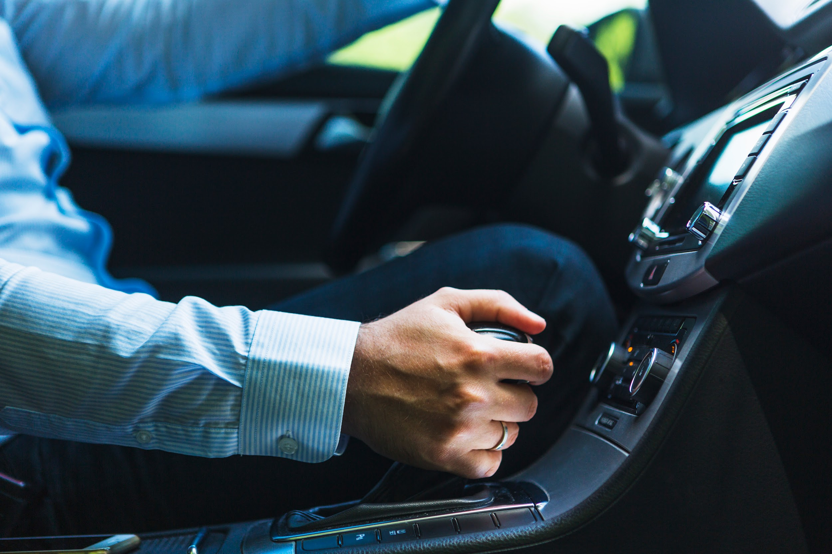
04
Output
HOME

Slide 31
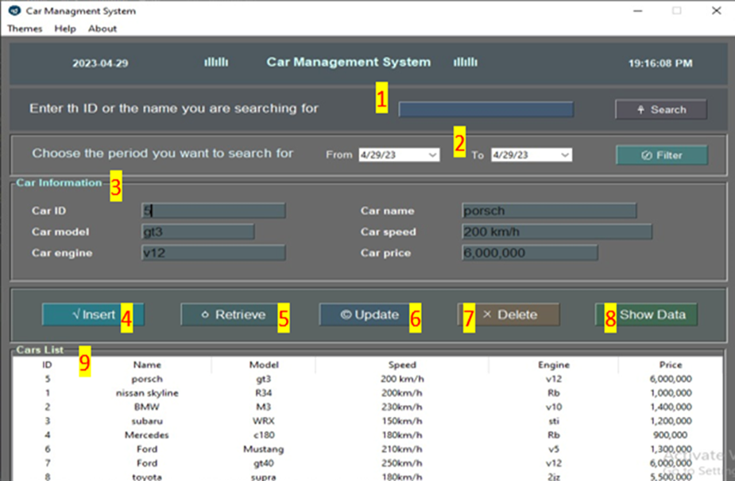
1- Search bar: Where you can search for specific car using ID 2-Filter bar: Where you can filter the car data according to the date inserted 3- Car information: Where car information appears 4- Insert Button: After completing car data press insert to insert the data 5- Retrieve Button: To retrieve car data 6-Update Button: To update the data of specific car 7-Delete Button: To delete car after inserting car id 8- Show Data Button: Shows the data of all cars 9- Cars list: Contains list of all cars in database

Slide 32
05
Conclusion
HOME

Slide 33
We propose a new design for the car information management system. This system will provide the benefit for customer’s car lovers, and Anyone interested in cars. The system currently available provides information on all types of cars. In the current system, customers can search and insert data car online. Interested car buyers can use this system to help them choose their suitable car from many cars in the databases with this approach, users can Search update delete, and insert new car info into the system. This design will help normal people to start to search for car information. Finally, this system provides good business for organizations and car owners, and for customers, it will be a good service.

Slide 34
Thank You

